Slide 1
Energy Shock and Macroeconomic Stabilization Experiments
Sander van der Hoog
GREQAM

Slide 2
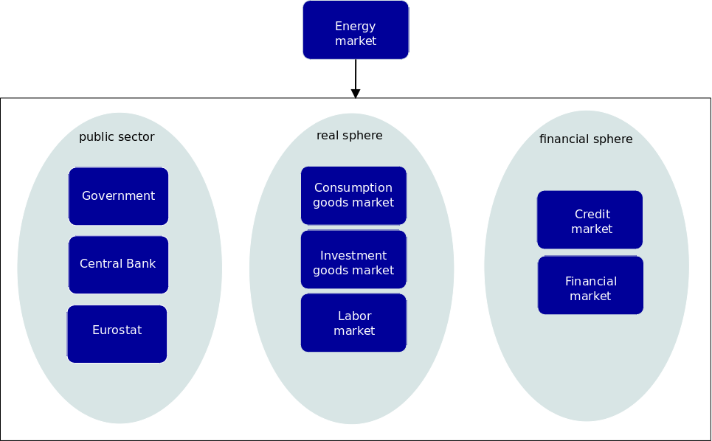

Slide 3
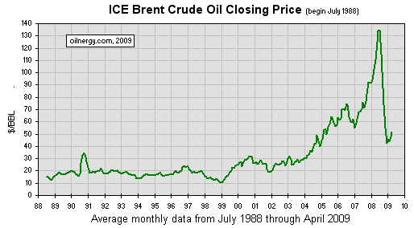
Chronology of an energy crisis Brent Crude Oil Price 1988 - 2009
Up: + 675% (2002.1-2008.6): r = + 2.45% monthly
Down: −70% (2008.7-2009.1): r = −5.8% monthly

Slide 4



How energy costs enter the model
Energy is supplied at an exogenously given price
The price of investment goods depends on
Technological progress: the productivity of investment goods increases stochastically over time.
An innovation is successful with prob. q= 10%; (i) productivity increases by 5% (ii) the capital goods price increases by 2.5%
Energy costs are incorporated into the price by an energy price mark-up

Slide 5

Consequences of the energy mark-up
How does an increase in the energy price affect consumer prices?
The revenues from the standard price increase are:
These accrue to the investment goods producer, and are paid out as taxes to government or as dividends to households.
The profits of the energy supplier leave the system:
The increased price for capital goods enters the production costs of the consumption goods producers, and is carried over to consumer prices.

Slide 6


Experimental setup
Parameters for the energy shock:
Duration (d ): the length of time during which (multiple) shocks may occur
Periodicity ( ): the periodicity at which shocks occur (# days)
Intensity ( ): the strength of each shock (%)
Name | Symbol | Values
duration | d | 240 days
periodicity |  | {0,20,60}
intensity |  | {1%,5%,10%}

Slide 7
Simulation settings
Transient phase: 1000 pre-iterations (4yrs), discarded for analysis
T=6000 days (25yrs)
1600 Households
80 Consumption good producers
1 Investment goods producer
2 Banks
1 Government
1 Eurostat – collects macro data

Slide 8
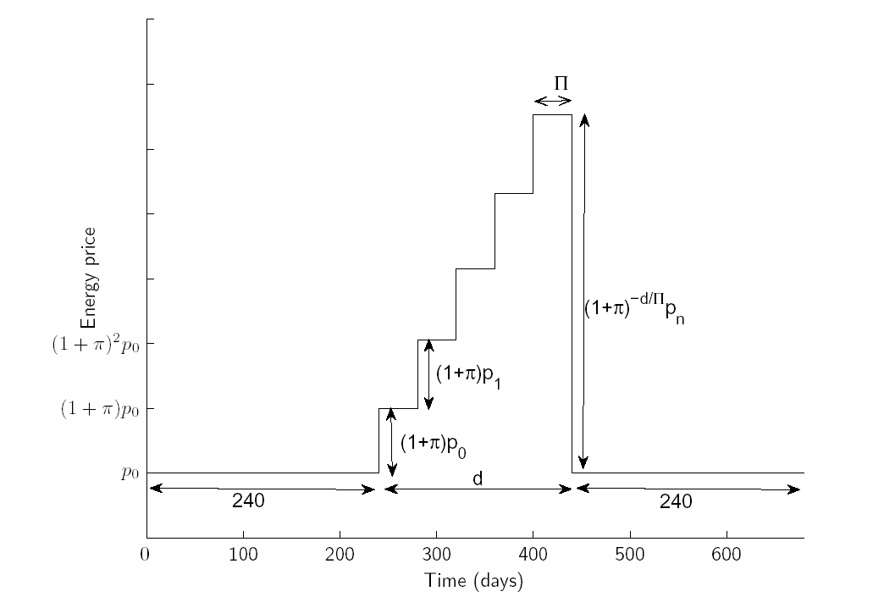
Time profile for cumulative shocks

Slide 9
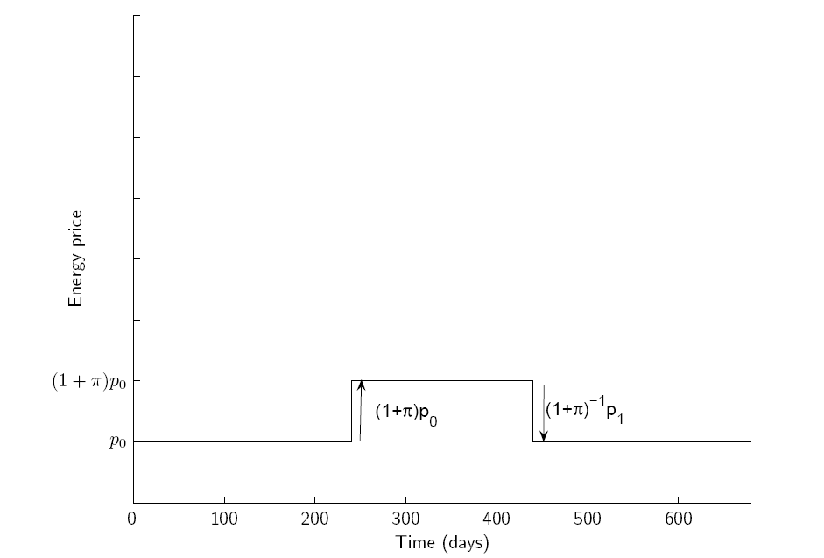
Time profile for a single shock

Slide 10
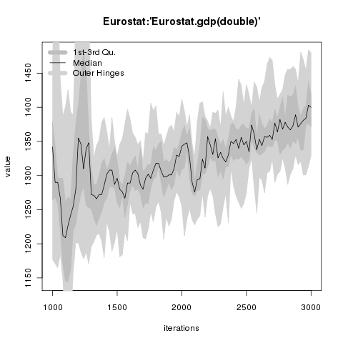
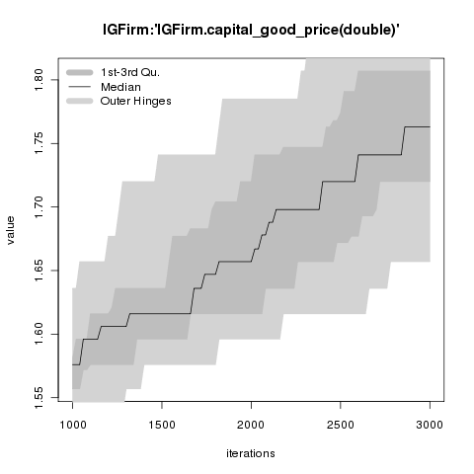
Benchmark Scenario

Slide 11
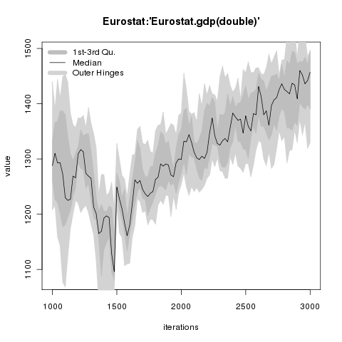
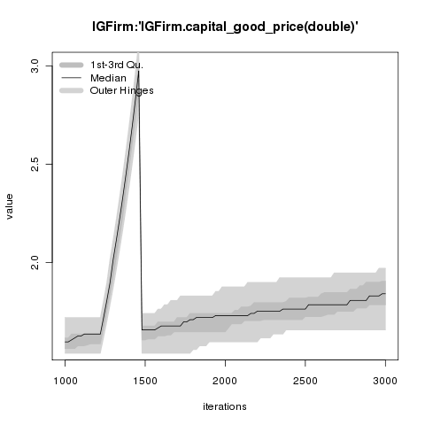
Energy shock example:
5%, every 20 days for 240 days
Notes:
Here we show the cumulative case where
we have multiple shocks of 5%, one every 20 days.
Here we see the signature of a true energy crisis, where at its peak capital goods cost 3 times as much as it did at the start of the crisis. The downward effect on GDP and unemployment is pronounced.
This case will now be used in the next section, where we introduce a macroeconomic stabilization policy to mitigate the effects of such a negative shock to the economy.

Slide 12
Macroeconomic stabilization policies
Main aim: to mitigate the negative effects of shocks to the macroeconomy
Focus is on the use of Household subsidies
to counteract the negative effects on:
GDP growth rate
unemployment
inflation
by directly stimulating consumption.

Slide 13
The consumer subsidy
The consumer subsidy is meant to compensate for the loss in purchasing power of the households.
Objective is to support the demand side of the economy.
Each household receives a subsidy as a percentage of its total monthly consumption expenditure.
Notes:
The household subsidy is a Bush-style tax rebate, giving every household a check to spend on consumption.
The anticipation should be that this does not help to stabilize the economy, as only real investments will bring the economy on a long-term higher growth level.
This experiment is therefore a test to see if our artificial economy also has this feature that spending yourself out of a recession is not a sustainable way of stimulating the economy. Long-term effects of such a scheme should be aggrevation of fluctuations.
Results: indeed the subsidy works on the short-term, and prevents the economy from going into recession, but only to the detriment of longer-term fluctuations in the growth levels.
The economy will swing wildly from +20% growth to -10% decline, instead of settling down to a stable 3% growth path.

Slide 14

Subsidy activation
The consumer subsidy is activated as a function of the GDP growth rate X, using two trigger levels a and b, with typically a<b.
The magnitude S (%) of the subsidy is given by

Slide 15
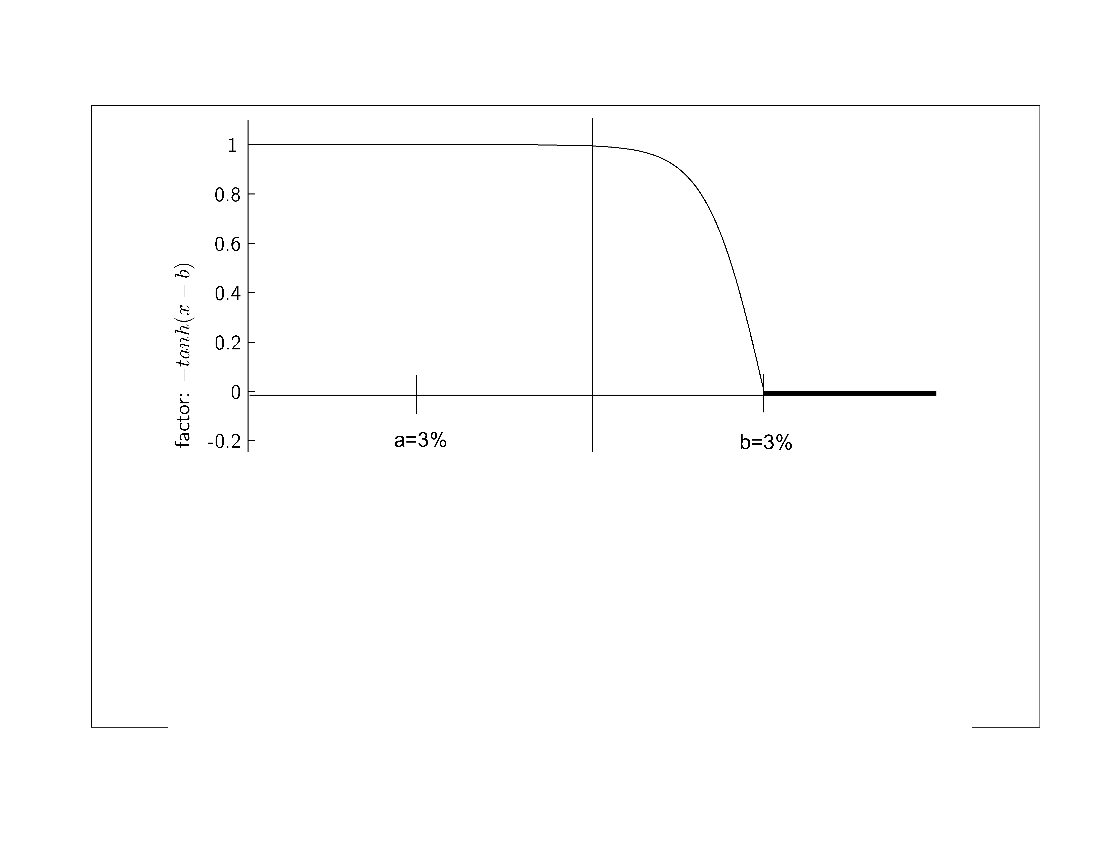
Subsidy scheme
Trigger on: a=-3%
Trigger off: b=+3%
Notes:
Subsidy regime formula.
Trigger to turn subsidy on: a=-3%
Trigger to turn subsidy off: b=+3%
For small negative growth rates, the subsidy percentage is moderate.
If the downturn becomes large, the subsidy percentage becomes equal to the absolute value of the GDP growth rate, to compensate households for their loss in purchasing power.

Slide 16
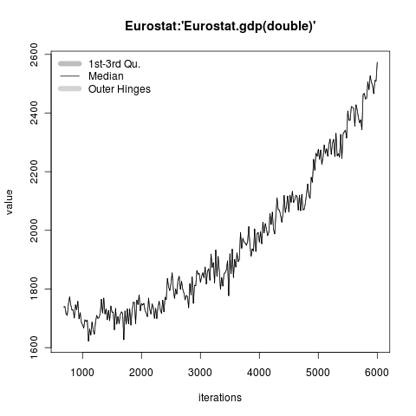
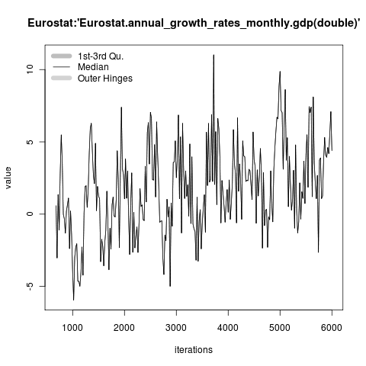
Benchmark run
Long-term GDP growth rate 2.5%

Slide 17
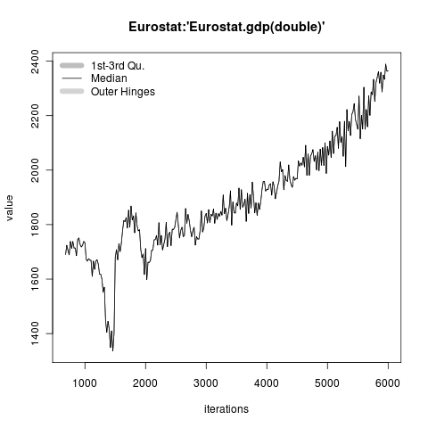
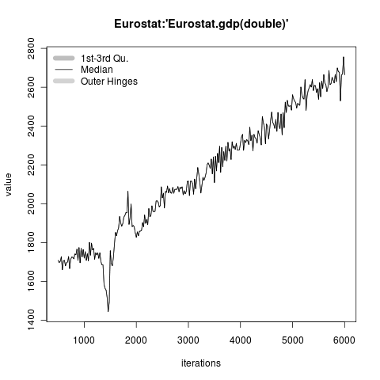
Effect of subsidy scheme
Energy crisis, no stabilization Energy crisis with stabilization
Notes:
The effect of the energy shock on GDP growth:
The energy crisis starts at t=1240 and ends at t=1480.
During the crisis we see a severe downturn of -15%,
Followed by a rebound of the economy after the crisis has ended.
On the long-term, the economy stabilizes to normal growth levels of 3%, with small fluctuations around this level.

Slide 18
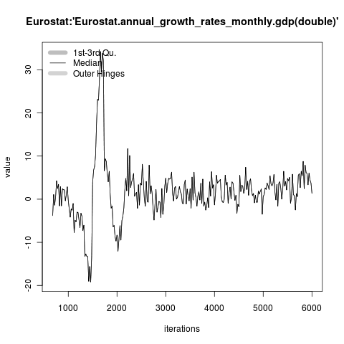
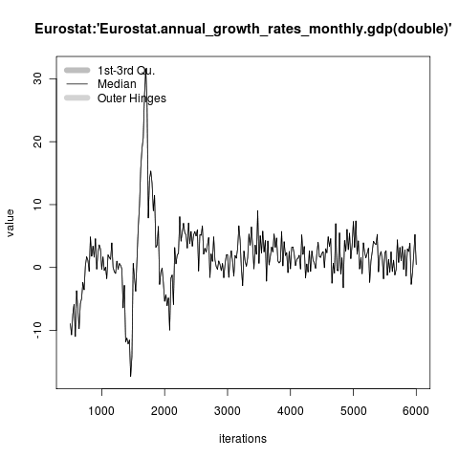
Effect on GDP growth
Energy crisis, LT growth 2.5% Energy crisis with stabilization
Notes:
Effect of the stabilization policy in the energy shock experiment.
Left panel: annual growth rate of GDP without the subsidy scheme.
Right panel: with the subsidy scheme. Activation of the subsidy regime occurs at t=1240.
Result:
Without the subsidy:
Due to the energy shock, the economy goes into recession with -15% GDP growth. Then after the crisis at t=1480, it rebounds to +10%. The long-term effect of the energy crisis wears off, and the growth rate settles down to 3% without large fluctuations.
With the subsidy:

Slide 19
Summary
Energy shock experiment
Energy prices are incorporated into the capital goods price by an energy price mark-up
We have shown how a prolonged energy crisis may affect GDP growth negatively
Subsidy experiment
Short-term: household consumption subsidies help to 'shoot' out of a recession on the short-run.
Long-term: the long-run growth rate is the same (real investment is not encouraged)
BUT: the level of nominal GDP is higher than without subsidy
Conclusion: without subsidy there is a permanent loss

